Slide 1
Fast Volume Rendering with Spatiotemporal Reservoir Resampling
Zhihao (ruanzh@seas.upenn.edu)
Shubham (sshubh@seas.upenn.edu)
Raymond (rayyang@seas.upenn.edu)
December 13, 2021

Slide 2
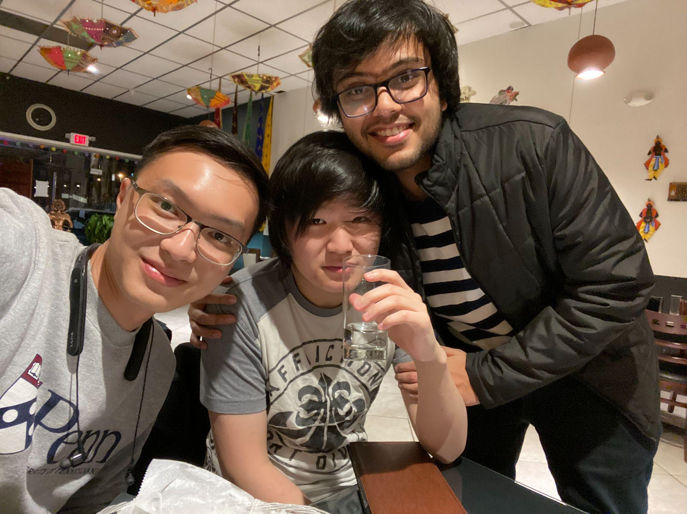
The Smokey Guys!
Github:
TheSmokeyGuys/Volume-ReSTIR-Vulkan
Zhihao Ruan (left):
M.S.E. in Robotics, Class of 2022
Raymond Yang (middle):
B.S.E in Computer Engineering, Class of 2022
Shubham Sharma (right):
M.S.E in CGGT, Class of 2022

Slide 3
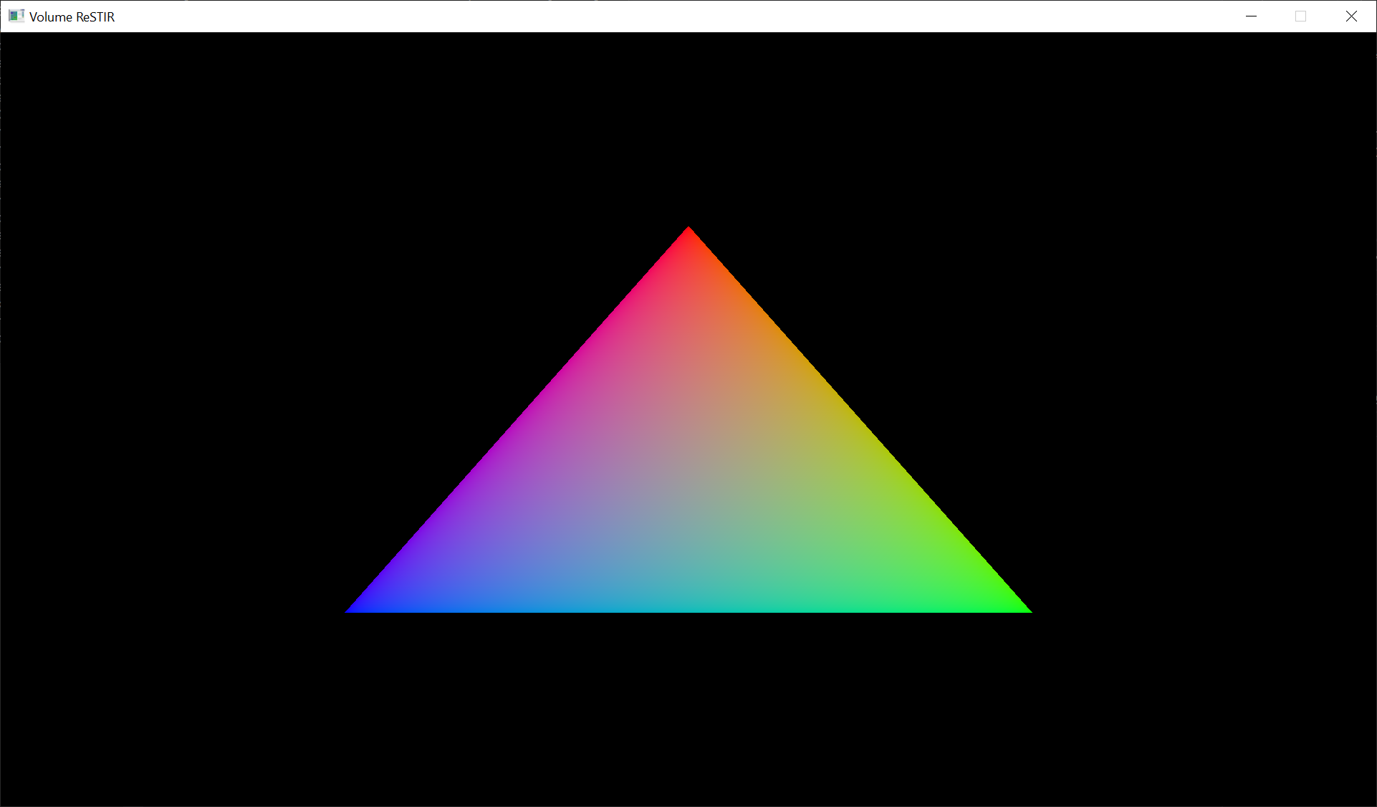
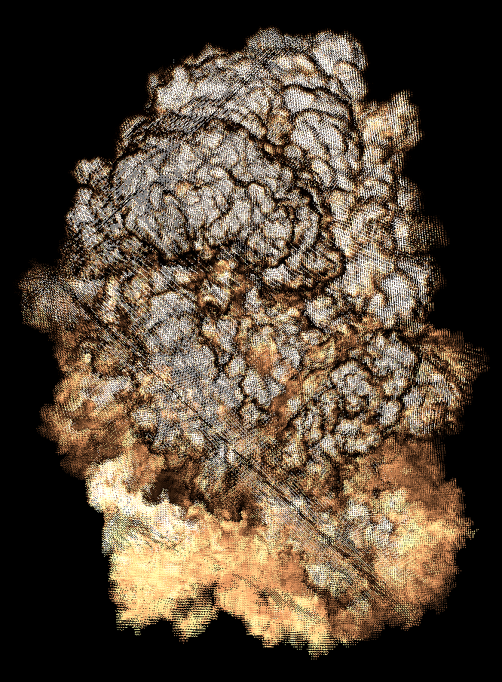
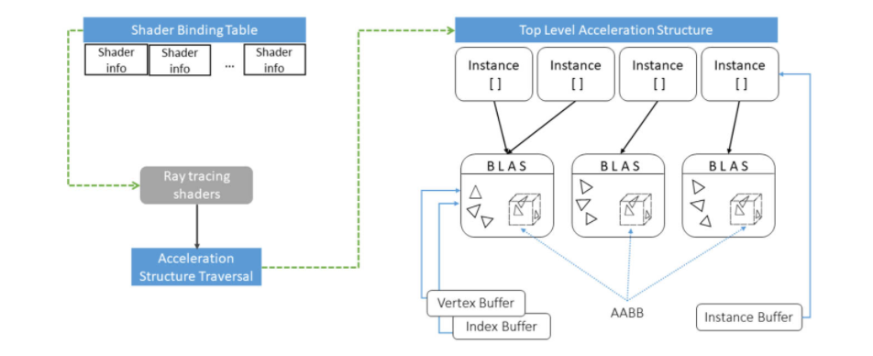
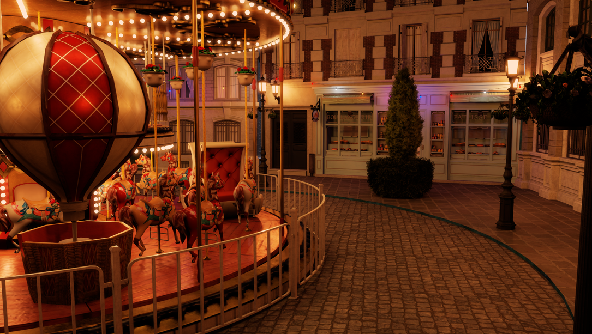

Project Overview
01
Project Setup Steps
Basic Vulkan Pipeline
Vulkan Pipeline with Vertex/Index Buffers
OpenVDB Integration
02
Exploring Vulkan
Vulkan Rasterizer with OpenVDB Assets
Vulkan Ray Tracing Shaders
Vulkan TLAS & BLAS
03
Exploring ReSTIR and VDB with ReSTIR
Reservoirs, Lights, and other Structs
ReSTIR Algorithm
Adaptation of Algorithm for Volume Rendering
04
Last Minute Touch Ups
ReadME
Extend GUI’s Interactivity
Final Code Refactor

Slide 4
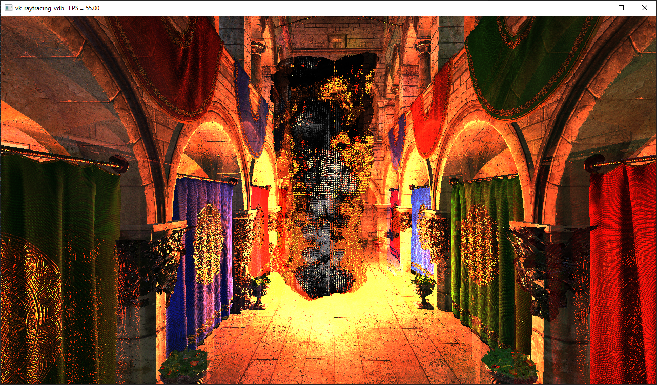
ReSTIR and VDB
RIS
Reservoirs
- Effective culling of light sets and sampling of light PDFs
- Flexible data structure for improving convergence rate
ReSTIR
Real time RGB convergence of pixels in complex scenes with large number of lights.

Slide 5
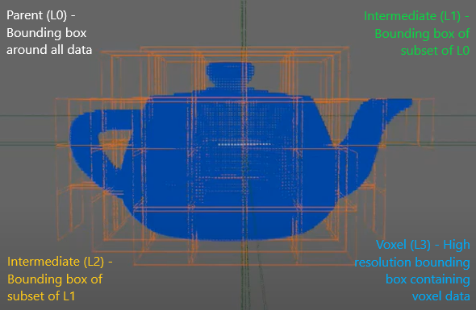
ReSTIR and VDB
Geom Hierarchy
Voxel Channels
- Compact data structure for sparse volumetric data sets
- High resolution details for position, velocity, etc.
VDB
Memory efficient data structure for point geometries.

Slide 6
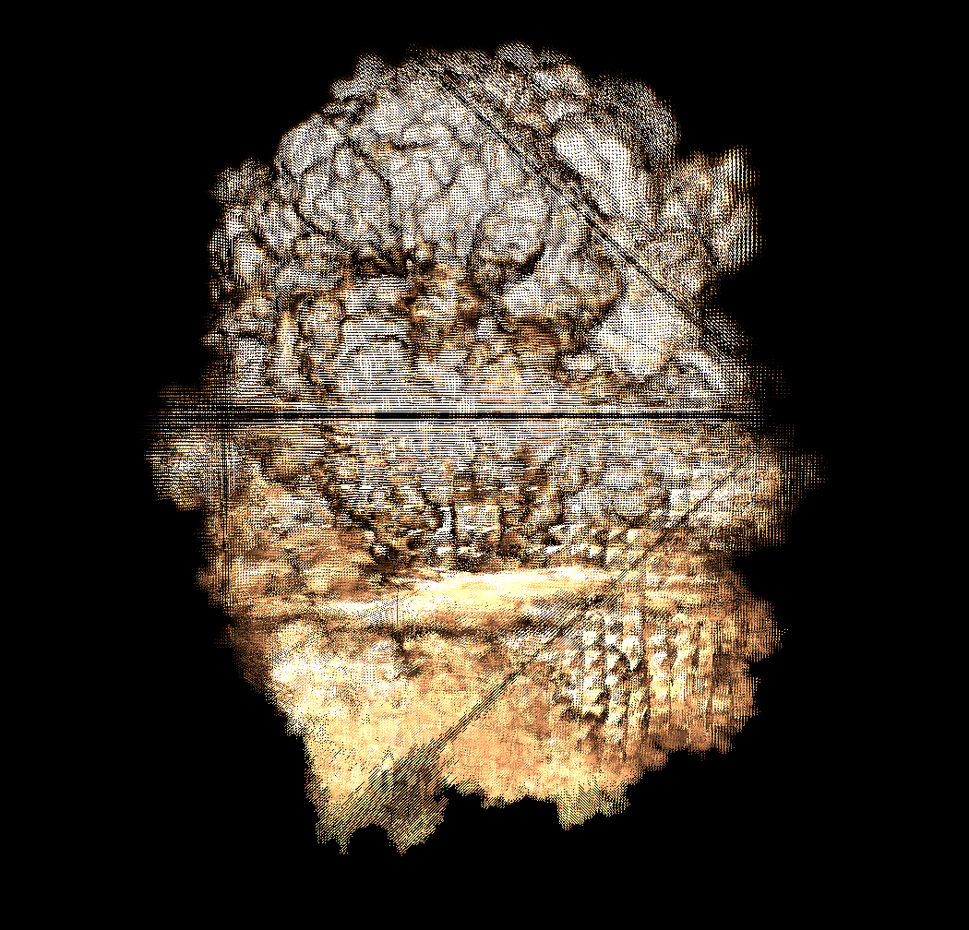
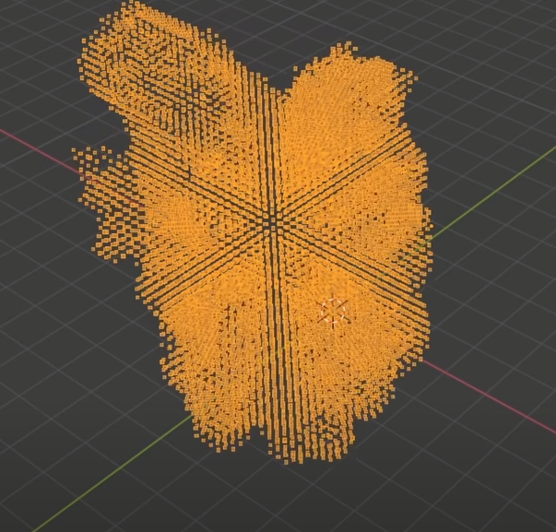
Houdini and VDB

Slide 7
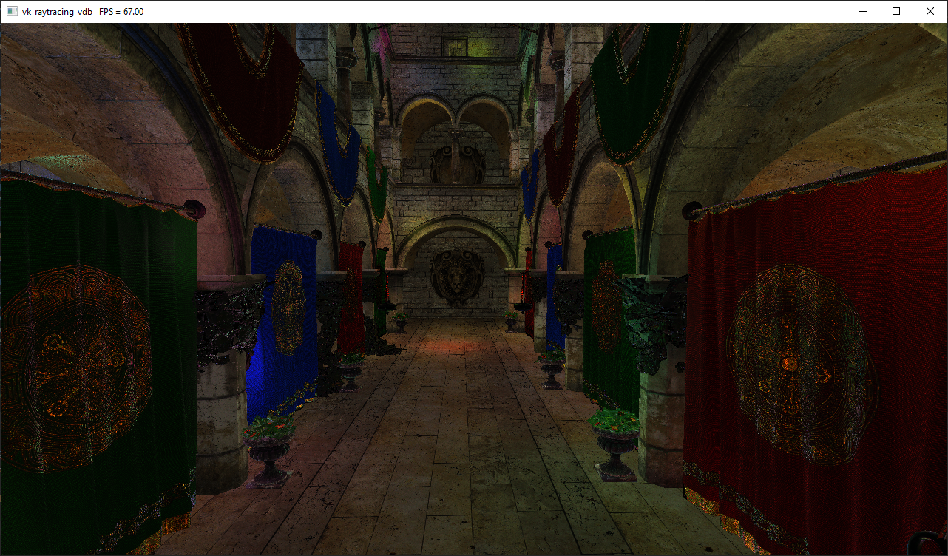
VDB & GLTF Interaction

Slide 8
VDB & GLTF Interaction

Slide 9
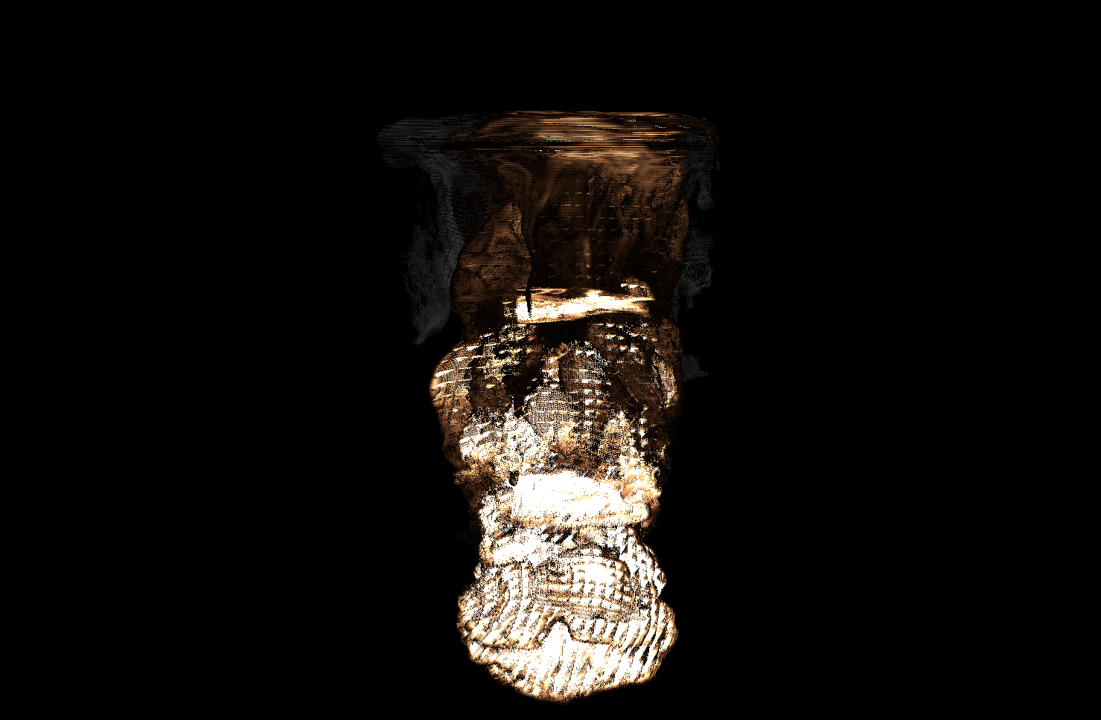
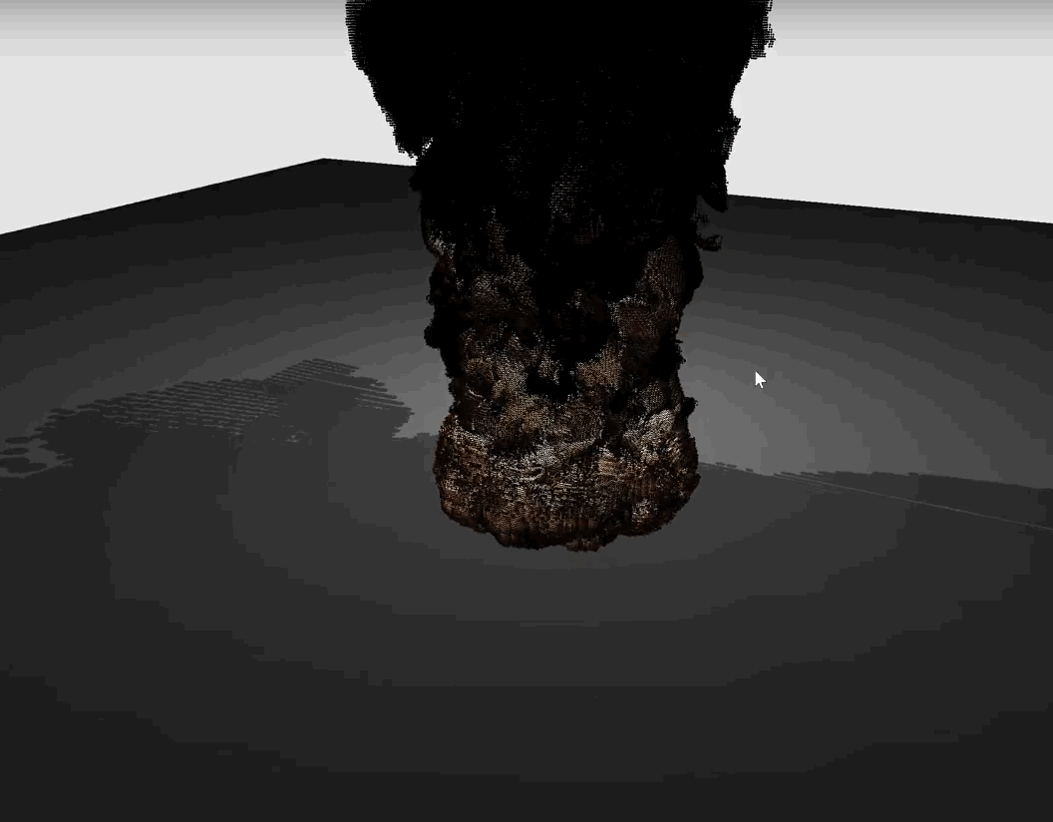
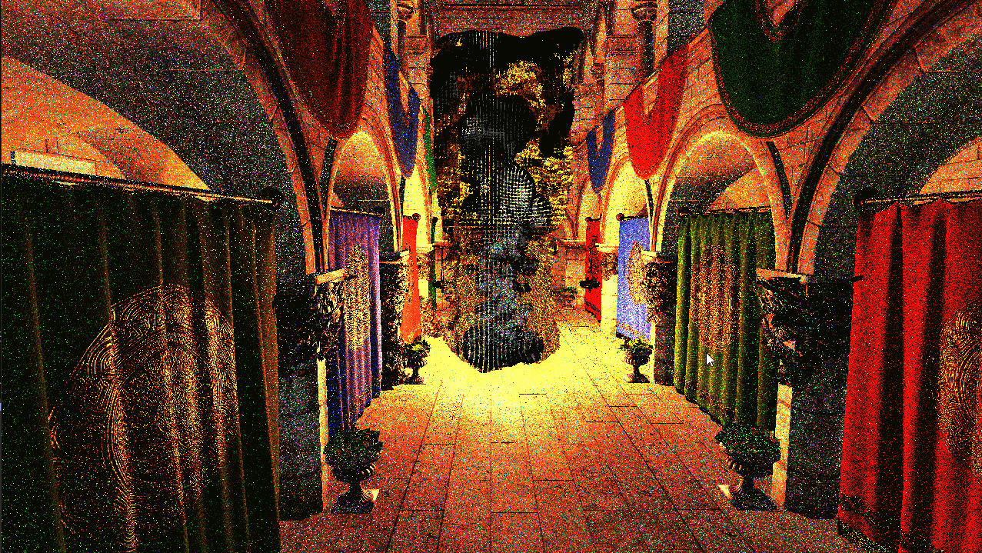
Rendering Methods
Rasterizer:
Path Tracer:
ReSTIR:

Slide 10

Adding Animation

Slide 11
Live Demo

Slide 12
Future Work
Fully integrate Fast Volume Rendering [12] into this project. Our current methods more closely follow ReSTIR [11], extended to VDB.
Extend interactivity of GUI to provide more user friendly, in-time ability to change models, lights, rendering mode, etc.
Q&A?

Slide 13
References
[1] Volume Rendering
[2] Volume Rendering (Nvidia)
[3] Ray Tracing Gems II
[4] Vulkan Ray Tracing with Intersection Shaders
[5] VK-Bootstrap
[6] OpenVDB
[7] Importance Resampling for Global Illumination
[8] Vulkan Ray Tracing Tutorial
[9] NVPRO Vulkan Mini Path Tracer
[10] Khronos Best Practices for Hybrid Rendering
[11] Spatiotemporal reservoir resampling for real-time ray tracing with dynamic direct lighting (SIGGRAPH 2020)
[12] Fast Volume Rendering with Spatiotemporal Reservoir Resampling (SIGGRAPH 2021)
[13] nvpro-samples/vk_raytracing_tutorial_KHR
[14] dipmizu914/ReSTIR_on_Vulkan

Slide 14
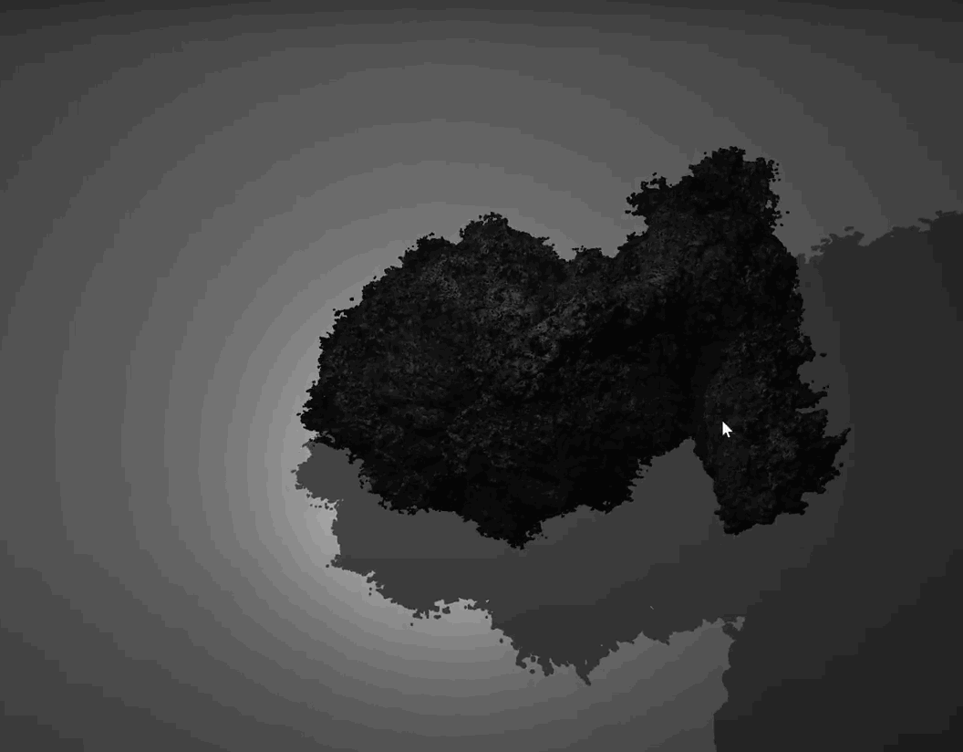
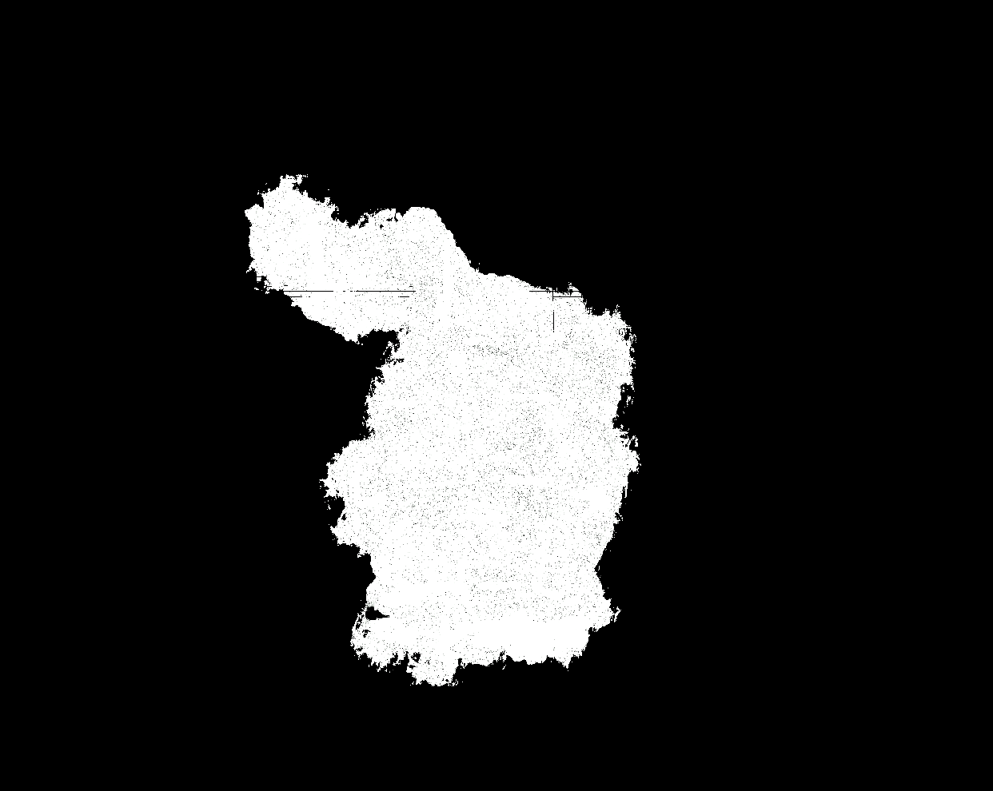
Path Traced Volume with Bunny
Asset: Rabbit
Voxel Count: 1,209,249
FPS: 130.9
Rasterized Image:

Slide 15
ReSTIR Volume with Fire
Asset: Fire
Voxel Count: 8,598,517
FPS:

